Slide 1

ASSIGNEMENT 1: needfinding
Marra Benito (s295220)
Grande Francesco (s296962)
Rota Luca (s303941)
Sciara Lorenzo (s303462)

Slide 2
DOMAIN OF INTEREST
We chose the preparation of medical training, because we thought it could improve the daily activities that a medicine student does.
The interviews were made by all the group members, divided into groups of 2 people, with the only exception of the extreme user that was interviewed by the whole group together.

Slide 3
Background Questions
What’s your name?
What’s your occupation?
How old are you
Can i call you …?
Do i have your authorization to share and to elaborate your answers in this interview?
When and how did your passion for medicine start?
How long have you been in the field of medicine / do you study in this area?
How is your relationship with technology? How much do you use technology in your daily life?

Slide 4
Going deep Questions
How do you estimate the average practical ability of students when they start the training? (extreme)
How did you estimate his practical ability at the time he started his training? How would you compare it to the current level of medical students? (extreme)
How do you consider your practical ability once you have finished your training? (extreme)
What does the current training consist of?
Can you explain in detail how the pre-training and training for medical students are constituted?
How much time does it take in practical training compared to theory? (immediate)

Slide 5
Going deep Questions
How much time do students spend in the practical training compared to the theoretical part? (extreme)
How were the trainings supported during the Covid period?
(da evitare) How would you rate the possibility of being able to exercise more at home?(immediate)
How would you evaluate the possibility for your students to practice more at home?(extreme)
How much did you spend to buy the tools to be able to exercise? Such as the stethoscope
Do you believe that the equipment provided to students is sufficient for their pre-training?

Slide 6
Clarification/Successes and failures questions
On a scale from 1 to 10, how do you rate the medical education system in Italy?
On a scale from 1 to 10, how did you estimate your practical ability when starting your training? (immediate)
In your opinion, what is an advantage and a disadvantage of your training? (student)
In your opinion, what is an advantage and a disadvantage of the trainings you have followed? (professor)
In your opinion, what are the three most deficient points of the current training system in relation to the organizational system? (professor, extreme)
So, given the opportunity, what would improve the current training system?

Slide 7
Reflection Questions
What do you think about Virtual/Augmented Reality in this field? Do you think that it could be helpful towards the actual system?
Do you think that the Medical Educational System could change in the short future?

Slide 8
The Inteviews to immediate users
All the interviews were made by two of us, one asking the questions and the other one taking notes of the interviewee’s answers, and were audio recorded. We have chosen students who have different experience with the trainings: one, for example, had never participated to one of them, whereas another student had already ended all the trainings. The reason behind this choice is that we wanted to underline their expectations and their final thoughts on the actual trainings in order to highlight which problems there are in the current system and how to fix them. Before each interview a document was singed by the interviewees: it allowed us to use the pictures you will see in this presentation.

Slide 9
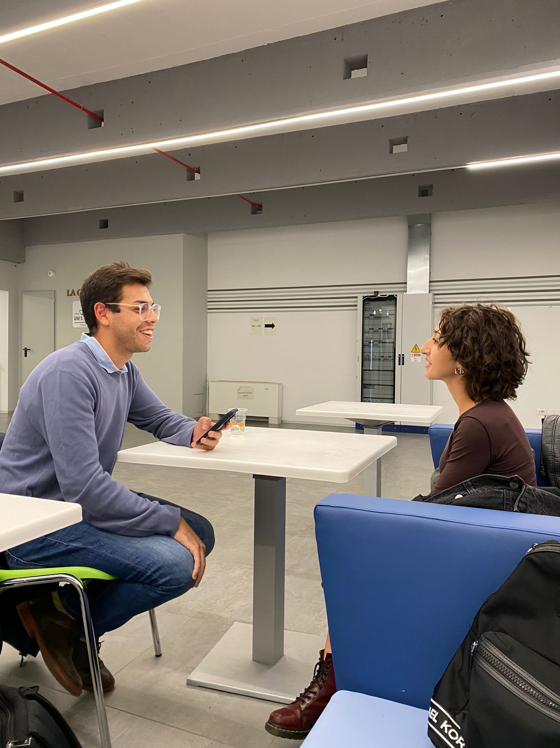
Gaia La Torre
Interviewed by Lorenzo and with Francesco taking notes, she is a 21 years old at her third year of medicine studies, who experienced the full Covid situation that didn’t allow her to follow the preparation courses. She was interviewed at UniTO in the medicine department

Slide 10
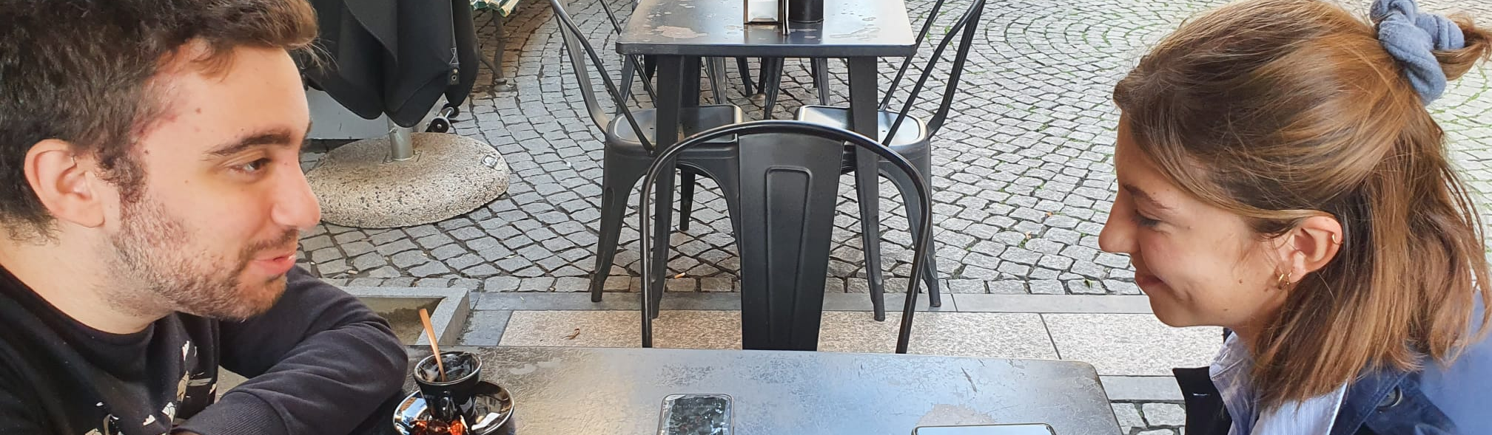
Cristina Gili
Interviewed by Benito and with Luca taking notes, she is a 22 years old at her fourth year of medicine, that followed 1 year of the preparation before the Covid-19 disease and started soon to do the in hospital experience. She was interview in a bar near the university.

Slide 11
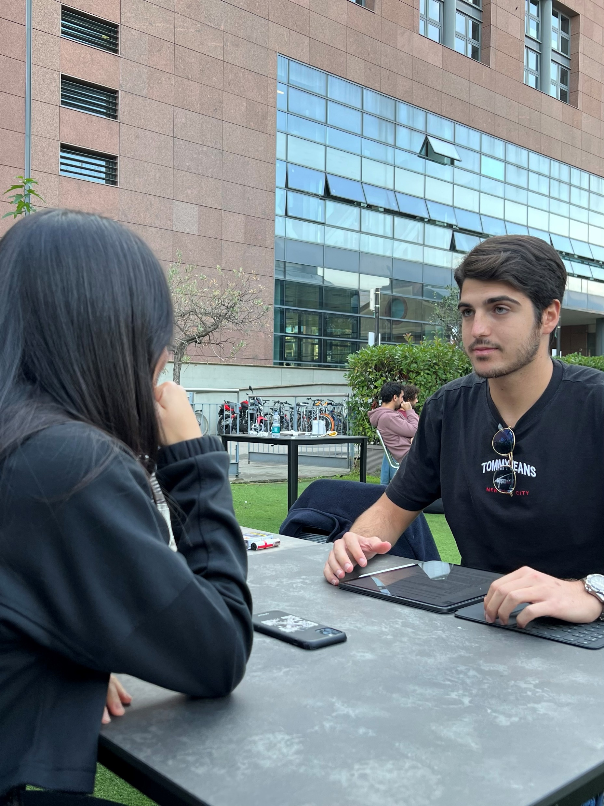
CAMILLA MONCHIO
Interviewed by Francesco and with Lorenzo taking notes,Camilla Monchio a 23 year old at her fourth year of medicine, differently from Cristina she only attended the preparation courses but didnt had a single experience in the hospital enviroment. She was interviewed in a bar near Politecnico.

Slide 12
The Inteview to The Extreme user
In the end we interviewed Grazia Papotti , one of the hospital medical director who is in charge of the trainings in «SimTO», a structure used by med students to train with fake bodies.
She was chosen since she has been doing this job for 20 years.
She’s experienced different methodologies toteach and probably knows well what the students are in need of and how to give them the best teachingexperience possible; in this particular case she is both an extreme user, because she is the main-head behind the formation of the training tutors and the manager of the pre trainings system; she is also an expert user because her knowledge on the field we are studying is verywide.

Slide 13
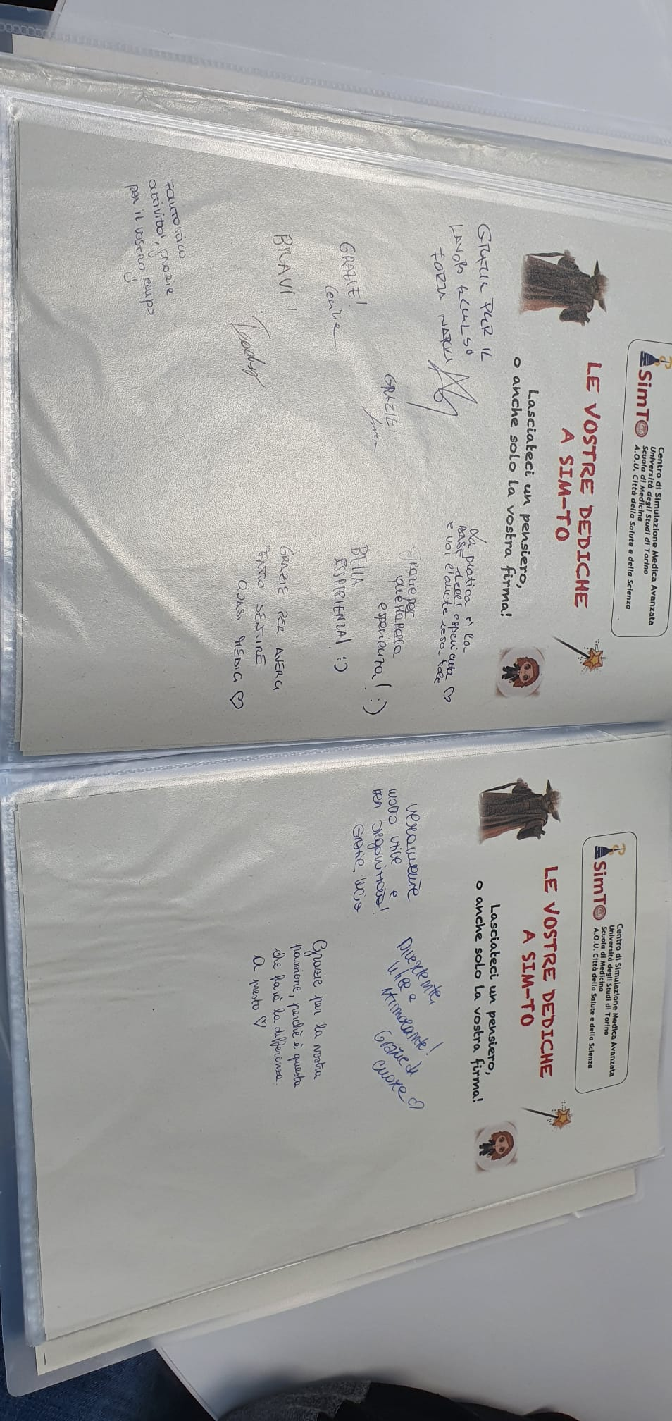
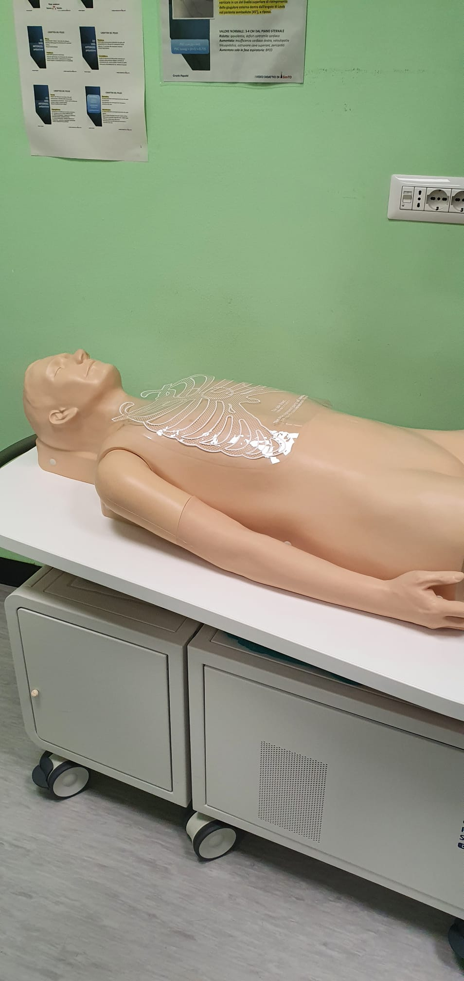
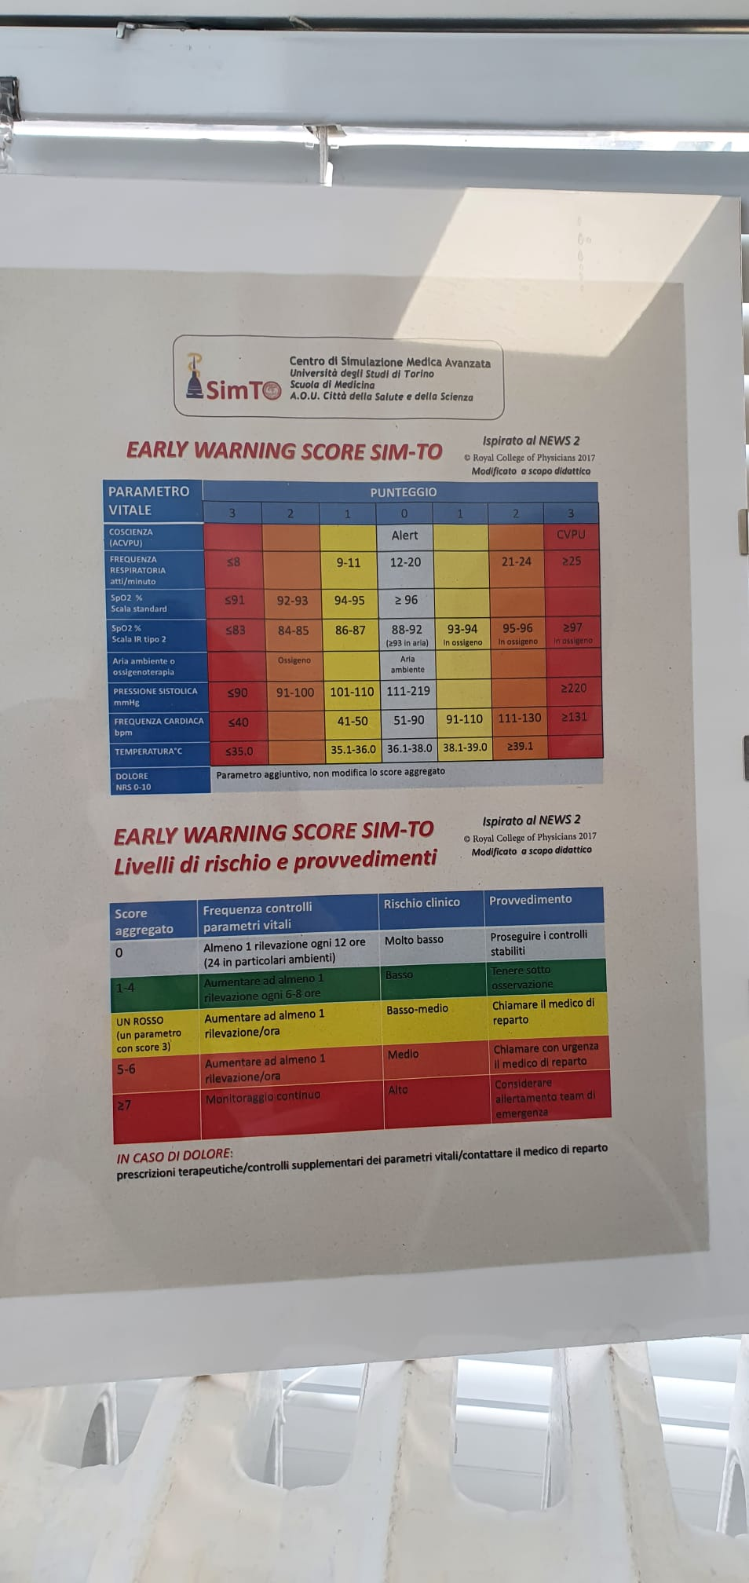
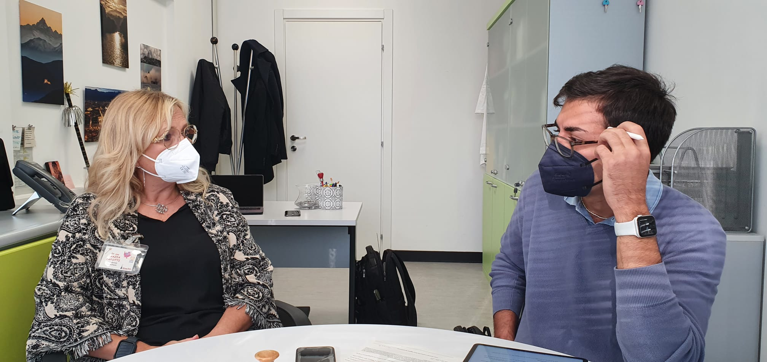
Some of the pictures we took at SimTo

Slide 14
What did we gather from the interviews?
All the students think that the training is not enough for the courses
The students don't believe in possible changes in the near future
The idea of being able to get some practice at home is exciting for everyone
Buying all the real tools might be expensive for some students
Students are disappointed by the actual medical education in Italy
Trainings are made by prenotation, so it is not avaiable instantly

Slide 15
What did we learn from the extreme USer?
There are already a lot of softwares and simulators for first degree pre-training, but none of them are made with virtual reality
There are too few mannequins available compared to many students, due to the high price
There is a need to have more rooms to have more groups of students simultaneously
There is a need to save time because a student can only do 3 internships per year
There is a need to make the training experience more realistic
The virtual reality could be more useful in post-degree courses than pre-training courses, especially in the surgery field

Slide 16
needs
Students need to spend more time in trainings
Students need to train with adequate training tools
Students need to experience a more realistic training
Training Manager to focus more time on the important aspect of the facility
Student must have a better basic preparation

